Slide 1
Unit 2
Game Trees

Slide 4
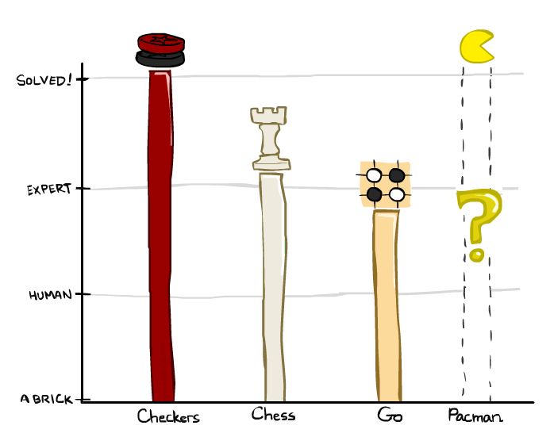
Game Playing State-of-the-Art
Checkers: 1950: First computer player. 1994: First computer champion: Chinook ended 40-year-reign of human champion Marion Tinsley using complete 8-piece endgame. 2007: Checkers solved!
Chess: 1997: Deep Blue defeats human champion Gary Kasparov in a six-game match. Deep Blue examined 200M positions per second, used very sophisticated evaluation and undisclosed methods for extending some lines of search up to 40 ply. Current programs are even better, if less historic.
Go: Human champions are now starting to be challenged by machines. In go, b > 300! Classic programs use pattern knowledge bases, but big recent advances use Monte Carlo (randomized) expansion methods.

Slide 5
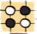
Game Playing State-of-the-Art
Checkers: 1950: First computer player. 1994: First computer champion: Chinook ended 40-year-reign of human champion Marion Tinsley using complete 8-piece endgame. 2007: Checkers solved!
Chess: 1997: Deep Blue defeats human champion Gary Kasparov in a six-game match. Deep Blue examined 200M positions per second, used very sophisticated evaluation and undisclosed methods for extending some lines of search up to 40 ply. Current programs are even better, if less historic.
Go: 2016: Alpha GO defeats human champion. Uses Monte Carlo Tree Search, learned evaluation function.
Pacman

Slide 6
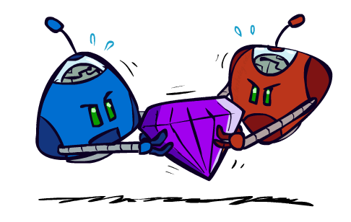
Adversarial Games

Slide 7
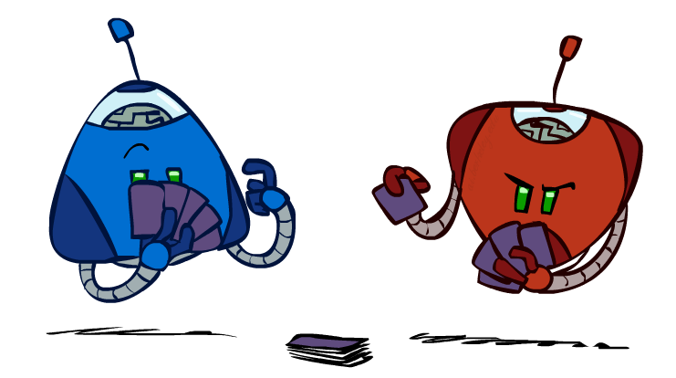
Types of Games
Many different kinds of games!
Axes:
Deterministic or stochastic?
One, two, or more players?
Zero sum?
Perfect information (can you see the state)?
Want algorithms for calculating a strategy (policy) which recommends a move from each state

Slide 8
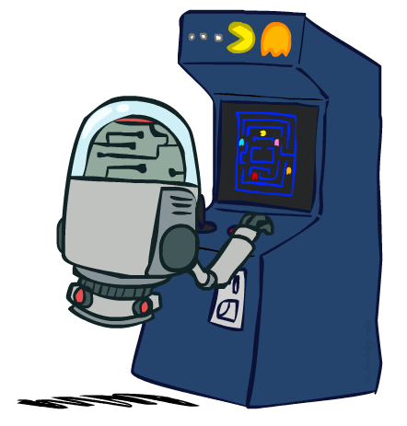
Deterministic Games
Many possible formalizations, one is:
States: S (start at s₀)
Players: P={1...N} (usually take turns)
Actions: A (may depend on player / state)
Transition Function: SxA → S
Terminal Test: S → {t,f}
Terminal Utilities: SxP → R
Solution for a player is a policy: S → A

Slide 9
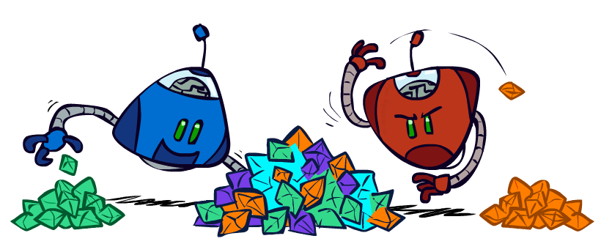
Zero-Sum Games
Zero-Sum Games
Agents have opposite utilities (values on outcomes)
Lets us think of a single value that one maximizes and the other minimizes
Adversarial, pure competition
General Games
Agents have independent utilities (values on outcomes)
Cooperation, indifference, competition, and more are all possible

Slide 10

Adversarial Search

Slide 11
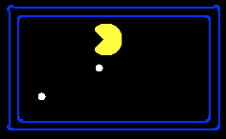
Single-Agent Trees
8
2
0
…
2
6
…
4
6

Slide 12
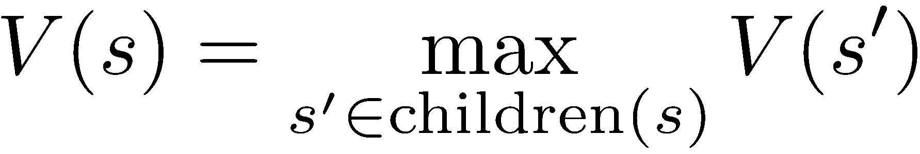
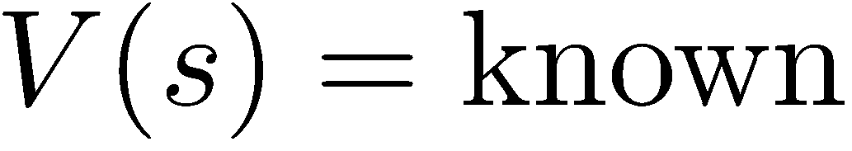
Value of a State
Value of a state: The best achievable outcome (utility) from that state
Non-Terminal States:
8
2
0
…
2
6
…
4
6
Terminal States:

Slide 13

Adversarial Game Trees
-20
-8
…
-18
-5
…
-10
+4
-20
+8

Slide 14
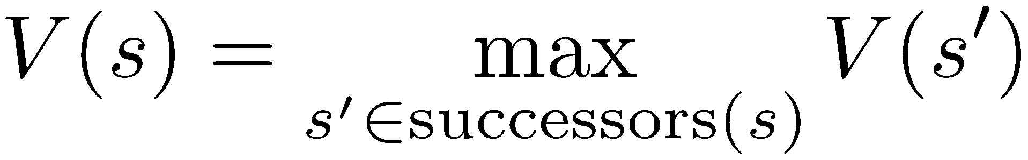
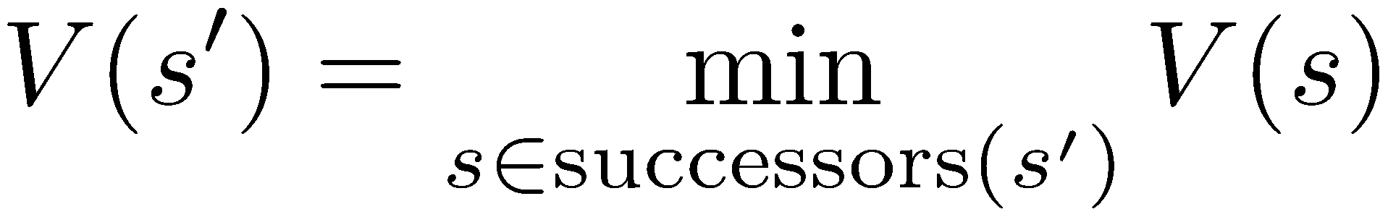
Minimax Values
States Under Agent’s Control:
States Under Opponent’s Control:
-8
-5
-10
+8
Terminal States:

Slide 15

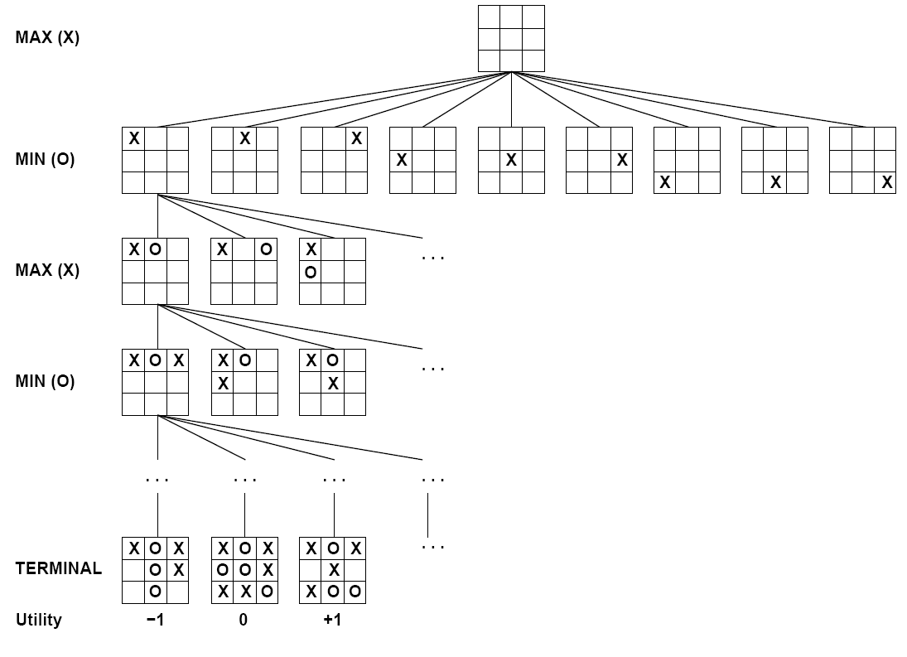

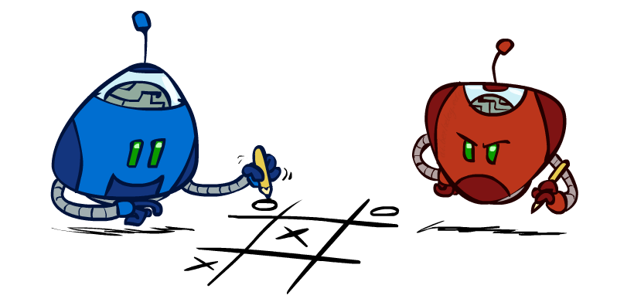
Tic-Tac-Toe Game Tree

Slide 16
Adversarial Search (Minimax)
Deterministic, zero-sum games:
Tic-tac-toe, chess, checkers
One player maximizes result
The other minimizes result
Minimax search:
A state-space search tree
Players alternate turns
Compute each node’s minimax value: the best achievable utility against a rational (optimal) adversary
Minimax values: computed recursively
5
max
2
5
min
8
2
5
6
Terminal values: part of the game

Slide 17
Minimax Implementation
def max-value(state):
initialize v = -∞
for each successor of state:
v = max(v, min-value(successor))
return v
def min-value(state):
initialize v = +∞
for each successor of state:
v = min(v, max-value(successor))
return v

Slide 18
Minimax Implementation (Dispatch)
def value(state):
if the state is a terminal state: return the state’s utility
if the next agent is MAX: return max-value(state)
if the next agent is MIN: return min-value(state)
def max-value(state):
initialize v = -∞
for each successor of state:
v = max(v, value(successor))
return v
def min-value(state):
initialize v = +∞
for each successor of state:
v = min(v, value(successor))
return v
Notes:
Pick an order for two reasons: sequential processor and pruning

Slide 21
Minimax Example
3
12
8
2
4
6
14
5
2

Slide 24
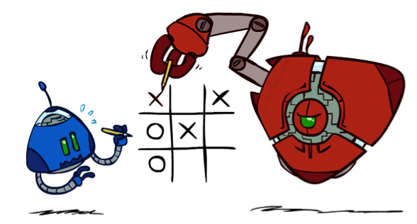
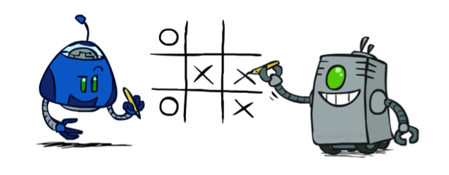
Minimax Properties
max
min
10
10
9
100
Optimal against a perfect player. Otherwise?

Slide 25
Minimax Efficiency
How efficient is minimax?
Just like (exhaustive) DFS
Time: O(b^{m})
Space: O(bm)
Example: For chess, b ≈ 35, m ≈ 100
Exact solution is completely infeasible
But, do we need to explore the whole tree?

Slide 26
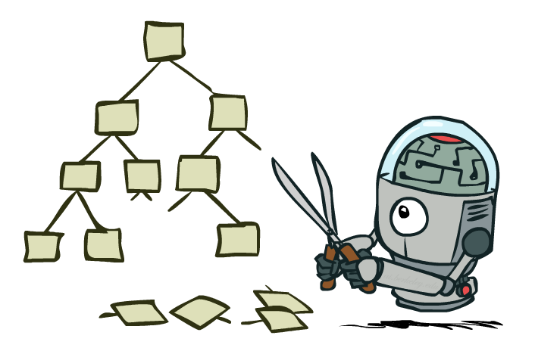
Game Tree Pruning

Slide 27
Minimax Example
3
12
8
2
4
6
14
5
2

Slide 28
Minimax Pruning
3
12
8
2
14
5
2

Slide 29
Alpha-Beta Pruning
General configuration (MIN version)
We’re computing the MIN-VALUE at some node n
We’re looping over n’s children
n’s estimate of the childrens’ min is dropping
Who cares about n’s value? MAX
Let a be the best value that MAX can get at any choice point along the current path from the root
If n becomes worse than a, MAX will avoid it, so we can stop considering n’s other children (it’s already bad enough that it won’t be played)
MAX version is symmetric
MAX
MIN
a
MAX
MIN
n

Slide 30
Alpha-Beta Implementation
α: MAX’s best option on path to root
β: MIN’s best option on path to root
def max-value(state, α, β):
initialize v = -∞
for each successor of state:
v = max(v, value(successor, α, β))
if v ≥ β return v
α = max(α, v)
return v
def min-value(state , α, β):
initialize v = +∞
for each successor of state:
v = min(v, value(successor, α, β))
if v ≤ α return v
β = min(β, v)
return v
Notes:
Pick an order for two reasons: sequential processor and pruning

Slide 31
Alpha-Beta Pruning Properties
This pruning has no effect on minimax value computed for the root!
Values of intermediate nodes might be wrong
Important: children of the root may have the wrong value
So the most naïve version won’t let you do action selection
Good child ordering improves effectiveness of pruning
With “perfect ordering”:
Time complexity drops to O(b^{m/2})
Doubles solvable depth!
Full search of, e.g. chess, is still hopeless…
max
min
10
10
0

Slide 34
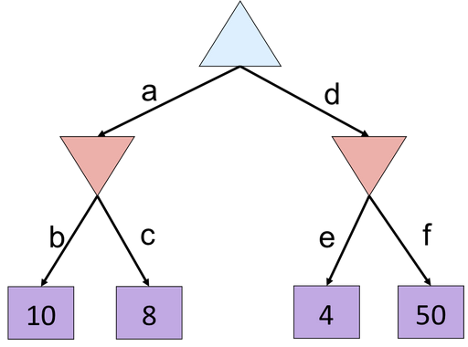
Alpha-Beta Quiz

Slide 35
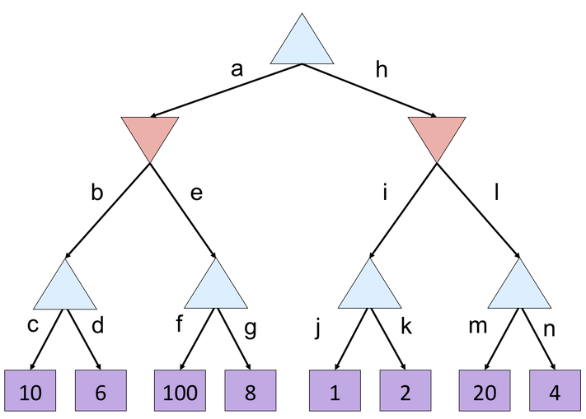
Alpha-Beta Quiz 2

Slide 39

Resource Limits

Slide 40
Resource Limits
Problem: In realistic games, cannot search to leaves!
Solution: Depth-limited search
Instead, search only to a limited depth in the tree
Replace terminal utilities with an evaluation function for non-terminal positions
Example:
Suppose we have 100 seconds, can explore 10K nodes / sec
So can check 1M nodes per move
α-β reaches about depth 8 – decent chess program
Guarantee of optimal play is gone
Use iterative deepening for an anytime algorithm
max
4
-2
4
min
-1
-2
4
9
?
?
?
?

Slide 41
Why Pacman Starves
A danger of replanning agents!
He knows his score will go up by eating the dot now (west, east)
He knows his score will go up just as much by eating the dot later (east, west)
There are no point-scoring opportunities after eating the dot (within the horizon, two here)
Therefore, waiting seems just as good as eating: he may go east, then back west in the next round of replanning!

Slide 42
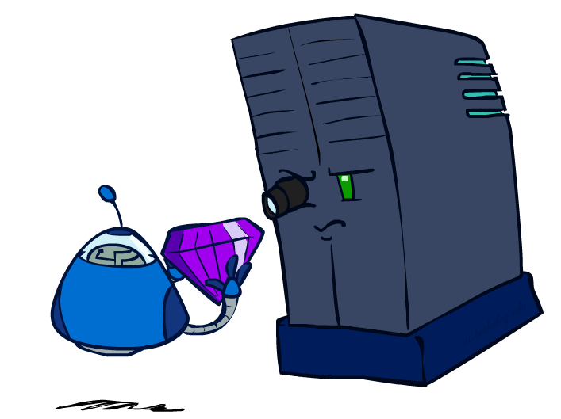
Evaluation Functions

Slide 43
Evaluation functions
Minimax algorithm generates the entire game space
Alpha-Beta pruning still has to search all the way to the terminal states
Algorithms should cutoff the search earlier and apply heuristic evaluation function. Turns non-terminal nodes to terminal leaves
Replace utility function by a heuristic function which estimates the position utility and replace the terminal test by a cutoff test.
Returns an estimate of the expected utility of the game from any given position
Order the terminal states in the same way as the true utility function
Computation must not take too long

Slide 45
Evaluation Functions
Evaluation functions score non-terminals in depth-limited search
Ideal function: returns the actual minimax value of the position
In practice: typically weighted linear sum of features:
e.g. f₁(s) = (num white queens – num black queens), etc.

Slide 46
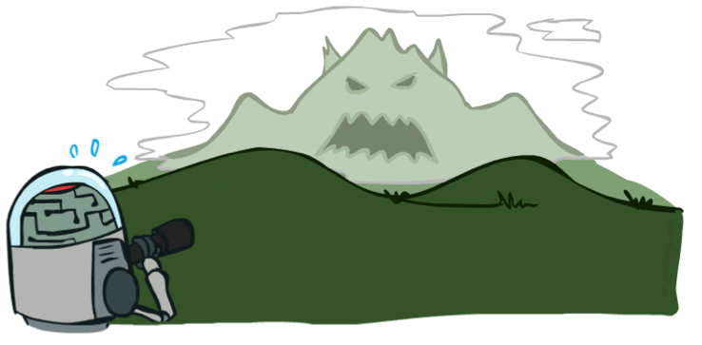

Depth Matters
Evaluation functions are always imperfect
The deeper in the tree the evaluation function is buried, the less the quality of the evaluation function matters
An important example of the tradeoff between complexity of features and complexity of computation
[Demo: depth limited (L6D4, L6D5)]

Slide 47
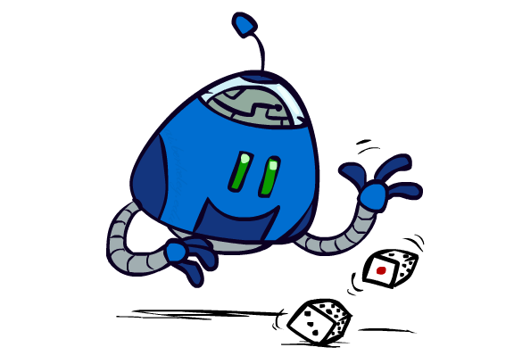
Uncertain Outcomes

Slide 48


Worst-Case vs. Average Case
max
min
10
10
9
100
Idea: Uncertain outcomes controlled by chance, not an adversary!
Notes:
At least 10, or otherwise just rather dead; or just 100, or otherwise rather dead; that’s yet something different than minimax or expectimax

Slide 50
Expectimax Search
Why wouldn’t we know what the result of an action will be?
Explicit randomness: rolling dice
Unpredictable opponents: the ghosts respond randomly
Actions can fail: when moving a robot, wheels might slip
Values should now reflect average-case (expectimax) outcomes, not worst-case (minimax) outcomes
Expectimax search: compute the average score under optimal play
Max nodes as in minimax search
Chance nodes are like min nodes but the outcome is uncertain
Calculate their expected utilities
I.e. take weighted average (expectation) of children
max
chance
10
10
4
10
5
9
7
100

Slide 51
Expectimax Pseudocode
def value(state):
if the state is a terminal state: return the state’s utility
if the next agent is MAX: return max-value(state)
if the next agent is EXP: return exp-value(state)
def max-value(state):
initialize v = -∞
for each successor of state:
v = max(v, value(successor))
return v
def exp-value(state):
initialize v = 0
for each successor of state:
p = probability(successor)
v += p * value(successor)
return v
Notes:
Pick an order for two reasons: sequential processor and pruning

Slide 52
Expectimax Pseudocode
def exp-value(state):
initialize v = 0
for each successor of state:
p = probability(successor)
v += p * value(successor)
return v
1/2
1/6
1/3
5
8
7
24
-12
v = (1/2) (8) + (1/3) (24) + (1/6) (-12) = 10

Slide 54
Expectimax Example
3
12
9
2
4
6
15
6
0

Slide 55
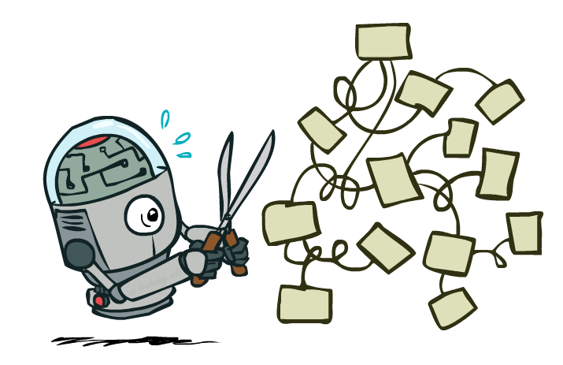
Expectimax Pruning?
3
12
9
2

Slide 56



Depth-Limited Expectimax
Estimate of true expectimax value (which would require a lot of work to compute)
400
300
…
…
492
362
…

Slide 57
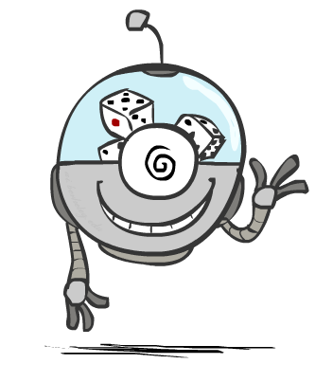
Probabilities

Slide 58
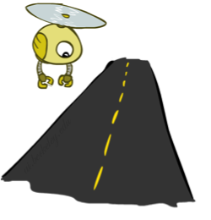
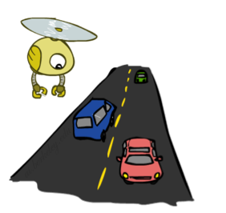
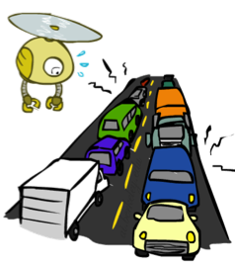
Reminder: Probabilities
A random variable represents an event whose outcome is unknown
A probability distribution is an assignment of weights to outcomes
Example: Traffic on freeway
Random variable: T = whether there’s traffic
Outcomes: T in {none, light, heavy}
Distribution: P(T=none) = 0.25, P(T=light) = 0.50, P(T=heavy) = 0.25
Some laws of probability:
Probabilities are always non-negative
Probabilities over all possible outcomes sum to one
0.25
0.50
0.25

Slide 59
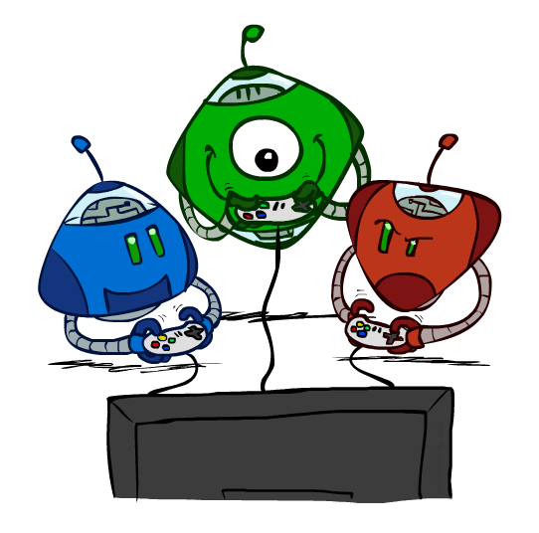
Other Game Types

Slide 60

Mixed Layer Types
E.g. Backgammon
Expectiminimax
Environment is an extra “random agent” player that moves after each min/max agent
Each node computes the appropriate combination of its children
Notes:
If it’s terminal or we reached our depth limit, return utility

Slide 61
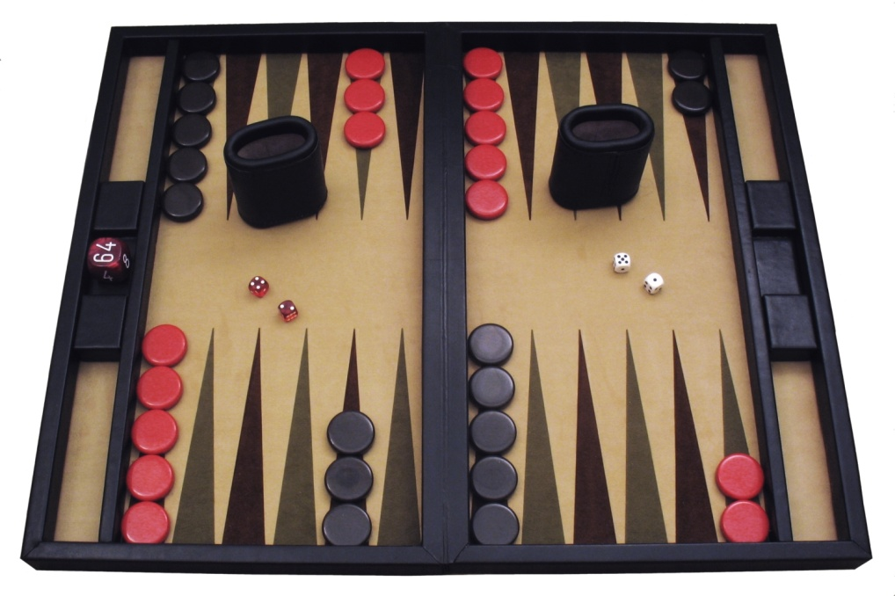
Example: Backgammon
Dice rolls increase b: 21 possible rolls with 2 dice
Backgammon ≈ 20 legal moves
Depth 2 = 20 x (21 x 20)³ = 1.2 x 10⁹
As depth increases, probability of reaching a given search node shrinks
So usefulness of search is diminished
So limiting depth is less damaging
But pruning is trickier…
Historic AI: TDGammon uses depth-2 search + very good evaluation function + reinforcement learning: world-champion level play
1st AI world champion in any game!
Image: Wikipedia

Slide 62
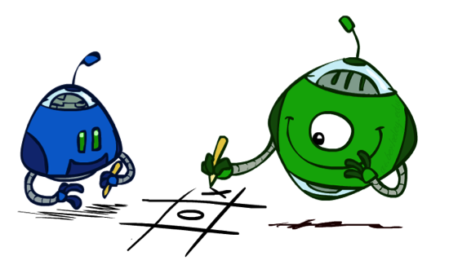
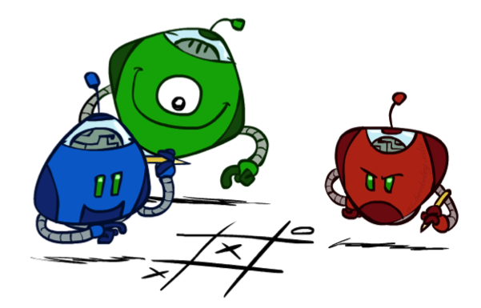
Multi-Agent Utilities
What if the game is not zero-sum, or has multiple players?
Generalization of minimax:
Terminals have utility tuples
Node values are also utility tuples
Each player maximizes its own component
Can give rise to cooperation and
competition dynamically…
1,6,6
7,1,2
6,1,2
7,2,1
5,1,7
1,5,2
7,7,1
5,2,5

